Slide 1




Digital portfolio :
Name: Rahiya Fathima.F
NMID: FD80785B6F6E71ABC52484BAD3D39B36/ asanm41341324213016
Register no:24134130500122016
Department: BCA
college: Deen college of arts and science

Slide 2
Student Digital portfolio

Slide 3
Agenda:
Problem statement
project overview
End users
Tools and technologies
portfolio design and layout
Features and functionality
Results and screenshot
conclusion
GitHub link

Slide 4
---
problem statement :
Traditional resumes are limited in showcasing creativity and technical skills. To overcome this, a personal portfolio website is needed to present Rahiya Fathima’s education, skills, projects, and hobbies in an engaging and professional way.
---

Slide 5
Project Overview:
This project is a personal portfolio website built using HTML, CSS, and JavaScript. It showcases my profile, education, projects, skills, hobbies, and contact details in a simple, modern, and user-friendly design.

Slide 6
End Users:
The end users of this portfolio website are recruiters, teachers, classmates, and professionals who want to view my profile, education, skills, and projects.

Slide 7
---
Definition of Tools & Technologies:
Tools and Technologies refer to the software, programming languages, frameworks, platforms, and applications that you use to design, develop, and deploy projects. They represent the technical stack and resources that help in solving problems, building applications, and improving productivity.
---

Slide 8
Portfolio design and layout:
A portfolio design and layout is the way information, visuals, and sections (like About, Education, Projects, Skills, Contact) are organized and styled in a portfolio. It defines the structure (layout) and appearance (design) to make the portfolio clear, professional, and visually appealing for viewers.

Slide 9
Features and Functionality :
Features → Visible parts of the portfolio like header, about, education, projects, skills, hobbies, and contact sections with styled design.
Functionality → Interactive parts handled by JavaScript, such as auto-generating skill and hobby tags, hover effects, animations, and displaying the current year in the footer.

Slide 10
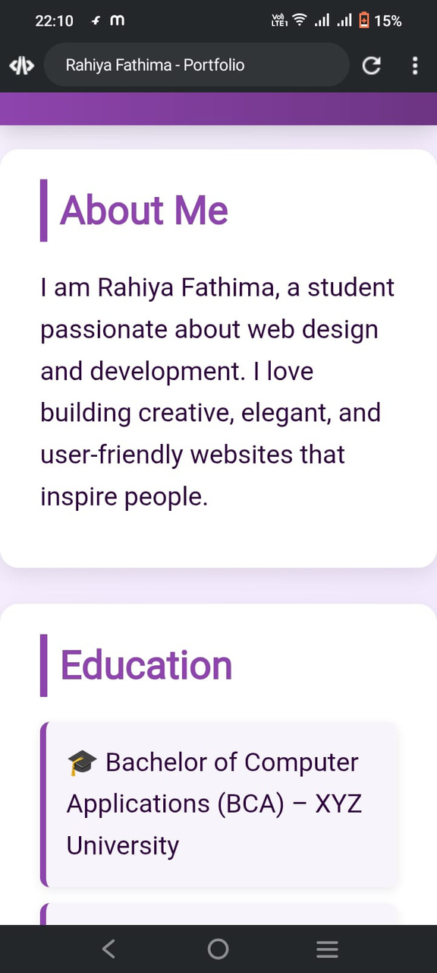
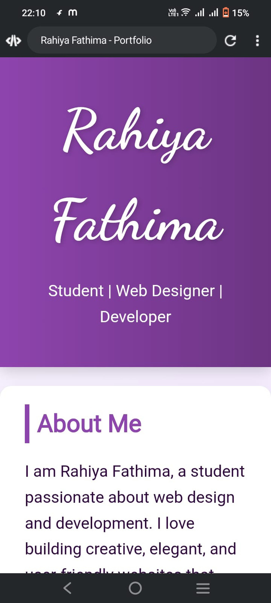
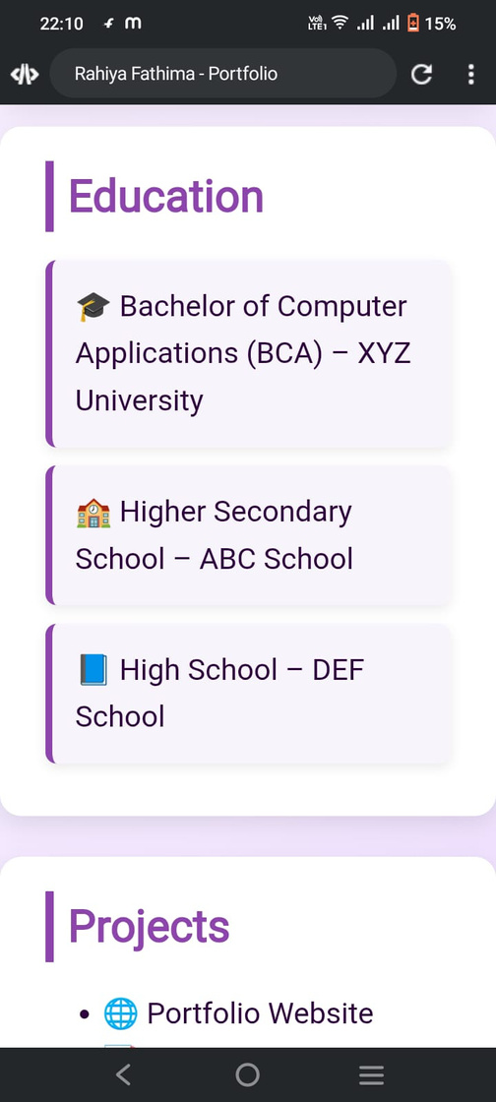
Results and screenshot:

Slide 11
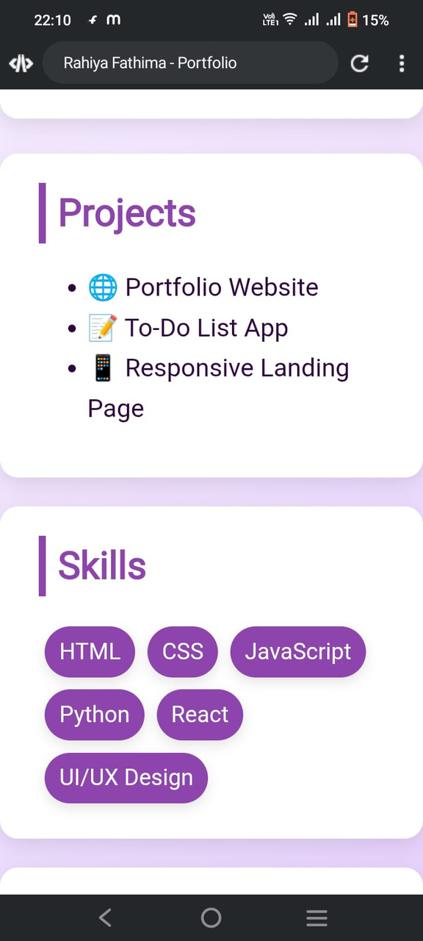
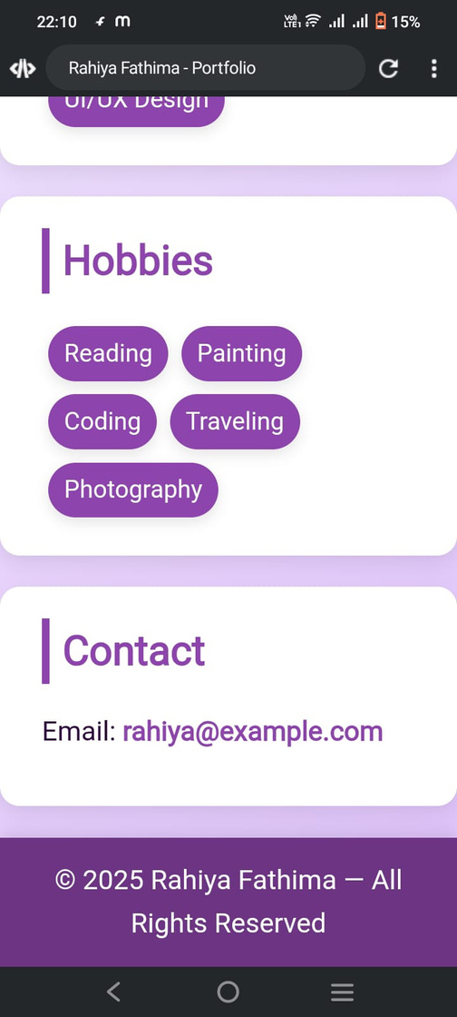
Results and screenshot:

Slide 12
Conclusion:
This portfolio program presents a well-structured personal website that highlights your details, education, projects, skills, hobbies, and contact information in a clean and attractive design. With the help of HTML for structure, CSS for styling, and JavaScript for interactivity, it creates a professional and user-friendly portfolio that can effectively showcase your profile to viewers.

Slide 13
GitHub link:
https://github.com/dcca24rahiya/rahiya-TNSDC-FWD-DP.git

